Slide 1
Building Enterprise Java Applications with Spring
Day 1
Magdalene Lim,
Desmond Lee,
Kavitha Muniraj
Republic Polytechnic

Slide 2
Welcome and admin matters
Please ensure that:
Attendance has been captured (via QR code scanning)
A learning laptop is with you
Good view on the display
Course materials are also available at: https://github.com/kavithamuniraj/CETSpringBootAY2022
Notes:
https://en.wikipedia.org/wiki/QR_code_payment

Slide 3
Admin matters
A tidy/clean laptop is a good laptop for learning
Files created on the laptop will linger on. To prevent this:
Create a folder in the "Documents" location for this workshop
E.g. “SpringBoot-Alan" or “SpringBoot-PeterPan“
All user created files to be placed in this folder
Delete that folder after the course
Notes:
https://en.wikipedia.org/wiki/QR_code_payment

Slide 4



Trainers
Magdalene Lim
Senior Lecturer
School of Infocomm
Magdalene_lim@rp.edu.sg
Desmond Lee
Associate Lecturer
School of Infocomm
DESMOND_LEE@myrp.edu.sg
Kavitha Muniraj
Lecturer
School of Infocomm
Kavitha_muniraj2@rp.edu.sg
Notes:
https://en.wikipedia.org/wiki/QR_code_payment

Slide 5
Schedule
Time | Agenda
9:00 am - 9:15 am | Welcome and admin matters
9:15 am – 10:30 am | Introduction to Payment Systems and Spring Boot
10:30 am – 10:45 am | Break
10:45 am – 12:30 pm | Spring Boot Set up & Create your first Project
12:30 pm – 1:30 pm | Lunch
1:30 pm – 3:15 pm | REST API – MVC concept
3:15 pm – 3:30 pm | Break
Break 3:30 pm – 4:45 pm | Styling a Webpage
4:45 pm – 5:00 pm | Wrap up, Q&A
Notes:
https://en.wikipedia.org/wiki/QR_code_payment

Slide 6
Topics Covered in this course
What is Spring Boot ?
Build an end to end Application
Spring Boot Features
Configuration and Customization
Responsive Web Design
Notes:
https://en.wikipedia.org/wiki/QR_code_payment

Slide 7

Web architecture: Client-Server
The client-server model is the most basic 2-tier web architecture.
In this model, the client requests for information from the server, and the server will respond by providing the information requested.

Slide 8
Some web terminologies
Web page
A document which can be displayed in a web browser such as Firefox, Google Chrome, or Edge.
Web site
A collection of web pages which are grouped together and usually connected together in various ways.
Web server
A computer that hosts a website on the Internet.
Client
The application(usually the web browser) on the laptop, computer, or mobile device, that is used to display the information returned by the web server

Slide 9
A website address/URL
Scheme or how the data is exchanged/transferred
Domain name
https://www.facebook.com/
URL
What is the difference between http and https?

Slide 10
E-Commerce
E-commerce (electronic commerce) is the activity of electronically buying or selling of products on online services or over the Internet.
E-commerce businesses may also employ some or all of the following:
Online shopping for retail sales direct to consumers via web sites and mobile apps.
Providing or participating in online marketplaces, which process third-party business-to-consumer (B2C) or consumer-to-consumer (C2C) sales;
Online financial exchanges for currency exchanges or trading purposes.
Note: It was designed with an e-commerce scenario and would cover most of what we need and is also relatable.
https://en.wikipedia.org/wiki/E-commerce

Slide 11
E-Commerce
To create an e-commerce site, various technologies will be required.
Front-end – To display the site to visitors
Client-side languages e.g. HTML, CSS, JS
Back-end – To process transactions
Server-side language e.g. Java, Python, PHP
Storage
Database e.g. MySQL, MSSQL, MongoDB
Payment - To accept and process payments
Payment solutions e.g. Paypal, Stripe

Slide 12
Payment Systems
A payment system is any system used to settle financial transactions through the transfer of monetary value.
This includes the institutions, instruments, people, rules, procedures, standards, and technologies that make its exchange possible.

Slide 13

Payment Systems
Different types of payment are:
Cash
Checks
Debit/Credit card
Bank Transfer (ACH, GIRO, SWIFT/Wire transfer)
Digital Wallets
Payment Technologies that make digital payments are broadly classified into :
Digital Wallets (paylah)
.QR code
Payment Gateways (Paypal)
Bank Transfer

Slide 14
Digital Payment Charges
Payment solutions | Fees
Paypal | 3.9% + SGD$0.50 (local sales) and 4.4% + Fixed Fee* (international sales)
Stripe | 3.4% + SGD $0.50 (credit and debit cards), 2.2% + SGD$0.35 (digital wallets such as Alipay and WeChat Pay) and 3.3% (GrabPay, Apple Pay and Google Pay)
DBS PayLah! | 3.00% (credit and debit cards) and 2% to 4% (for instalment plans). One-time setup fee of S$800 (subject to GST) Annual fee of S$1,000 (subject to GST)
eNets | 3.4% + SGD$0.50 (eNets Credit), 3.5% or SGD$1.50 (eNets IDD)
PayNow | Fees waived by most banks currently
Note: The fees is accurate when the module was designed, there could be changes now, for the exact fees, you must check in the relevant company website.

Slide 15
Digital Payment Advantage and Disadvantages
Payment solutions | Advantages | Disadvantages
Paypal | Global leader in online payments. Accepts payments via major debit and credit cards. Provides reporting and analytics features. | High transaction fees
Stripe | Accepts payments via major debit and credit cards. Supports other payment solutions such as Alipay, GrabPay, Apple Pay, Google Pay. Provides reporting and analytics features. | Fairly high transaction fees.
DBS PayLah! | Trusted locally Mobile No. or QR code | Setup and annual fees Local customers only
eNets | Trusted locally. Accepts Direct Debit in Singapore and all major credit cards. | Fairly high transaction fees.
PayNow | Fees waived Mobile No., NRIC or QR code | Local customers only*

Slide 16
What is Spring Boot ?
Spring Boot makes it easy to create stand-alone, production-grade Spring based Applications that you can "just run“
Stand- alone
Production ready

Slide 17
What is Spring ?
Application Framework
Programming and configuration model
Infrastructure support
(like connect to Mongo DB or SQL DB)
Notes:
Provides a template to create applications..
For example, it helps the user to focus on the business model and provides the model for the application you want to build
Annotate (@) the class to a service (http, database and so on)

Slide 18
Spring Framework ?
The Spring Framework provides a comprehensive programming and configuration model for modern Java-based enterprise applications.
The Spring Framework features its own model–view–controller (MVC) web application framework

Slide 19
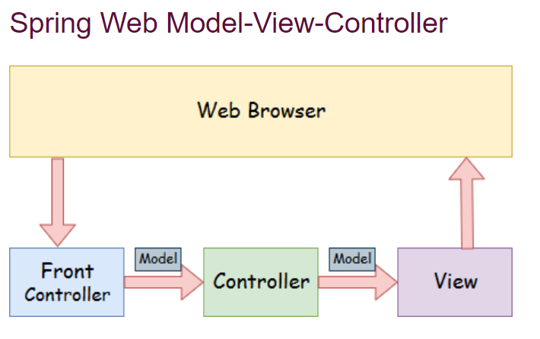
Spring MVC Framework ?

Slide 20
Spring MVC Framework ?
Model - A model contains the data of the application. A data can be a single object or a collection of objects.
Controller - A controller contains the business logic of an application. Here, the @Controller annotation is used to mark the class as the controller.
View - A view represents the provided information in a particular format. Generally, HTML file is used to create a view page. Although spring also supports other view technologies such as Apache Velocity, Thymeleaf and FreeMarker.
Front Controller - In Spring Web MVC, the DispatcherServlet class works as the front controller. It is responsible to manage the flow of the Spring MVC application.

Slide 21

BREAK

Slide 22
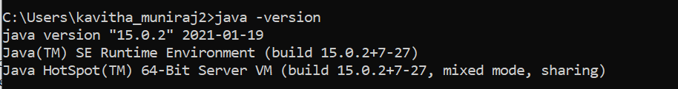
Spring Boot Set up – Software Requirements:
You need to install the following software:
Java 15
Eclipse
Spring Tools
Eclipse Web Development Tools
If you do not have any of the following installed, refer to the guide:
Notes:
100 different ways to build an application it can be confusing too.

Slide 23
Software Requirements
You should also have set the authorship in Eclipse. Refer to the document attached for the steps on setting the authorship
/** * * I declare that this code was written by me, ${user}. * I will not copy or allow others to copy my code. * I understand that copying code is considered as plagiarism. * * Student Name: Bobo Chan * Student ID: 654321 * Class: ABC1 * Date created: ${id:date('YYYY-MMM-dd')} ${time} * */

Slide 24

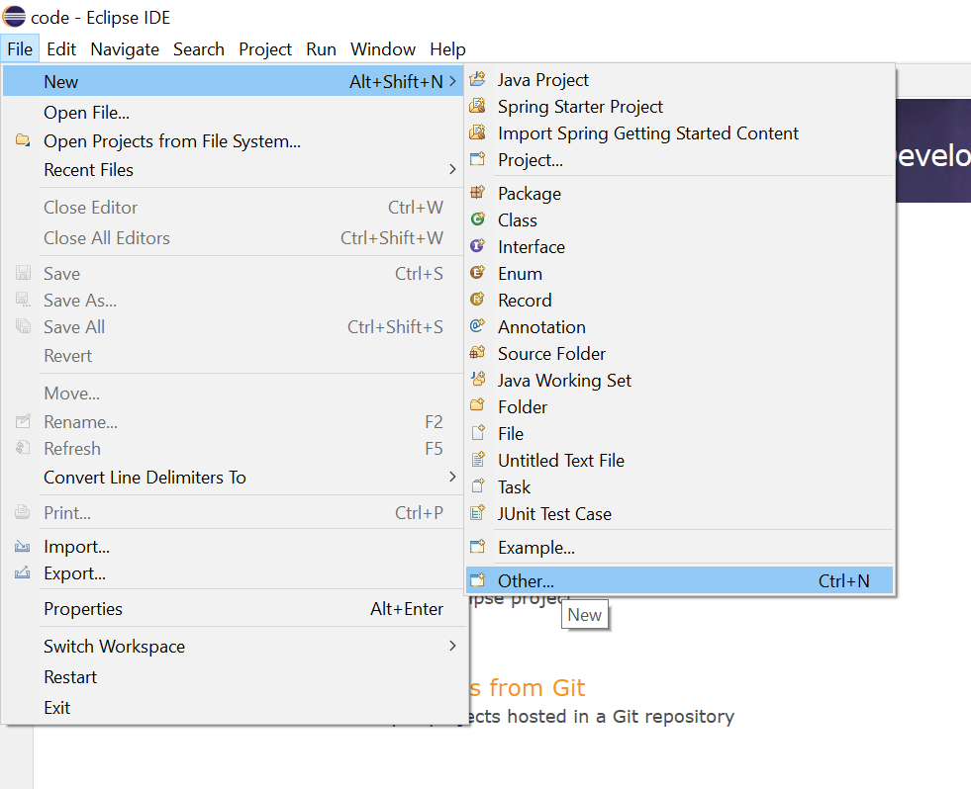
Exercise 1 – Create your first project
Start Eclipse and select a suitable workspace
Go to File > New > Other

Slide 25
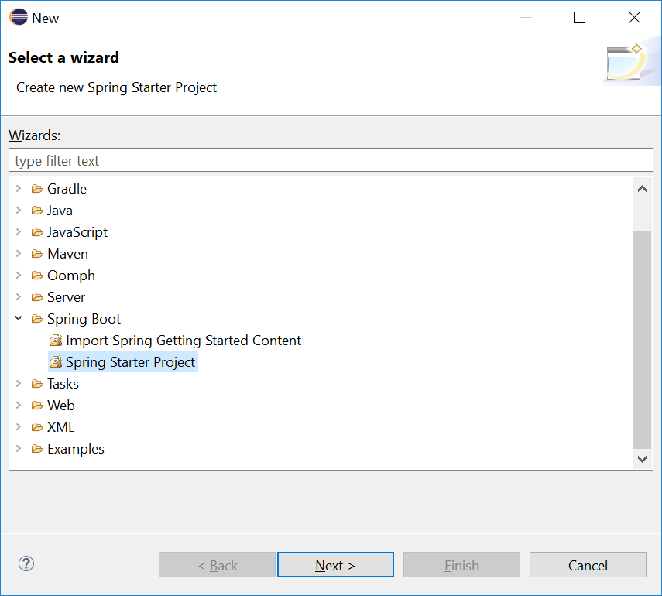
Exercise 1 – Create your first project
Select Spring Starter Project and click Next.
Your WiFi must be connected in order to download the necessary files related to a Spring Starter Project.

Slide 26
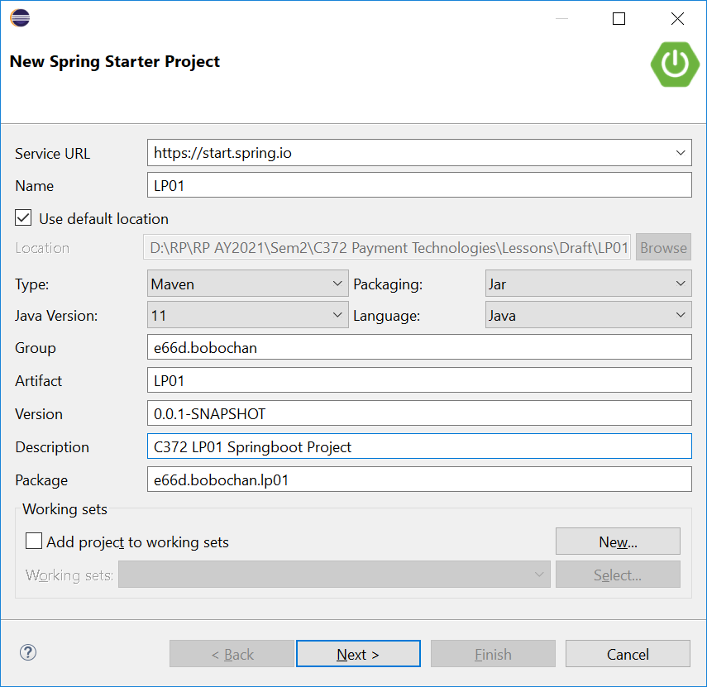
Exercise 1 – Create your first project
Edit the details as shown.
Click Next.
Java version 8 and above should work fine.
Use naming convention for package:
studentClass.studentname.lp01
See screenshot for example
Note:
Package names will be checked for submissions, including graded assignment submissions.
Notes:
Remind students to work on their own code.

Slide 27
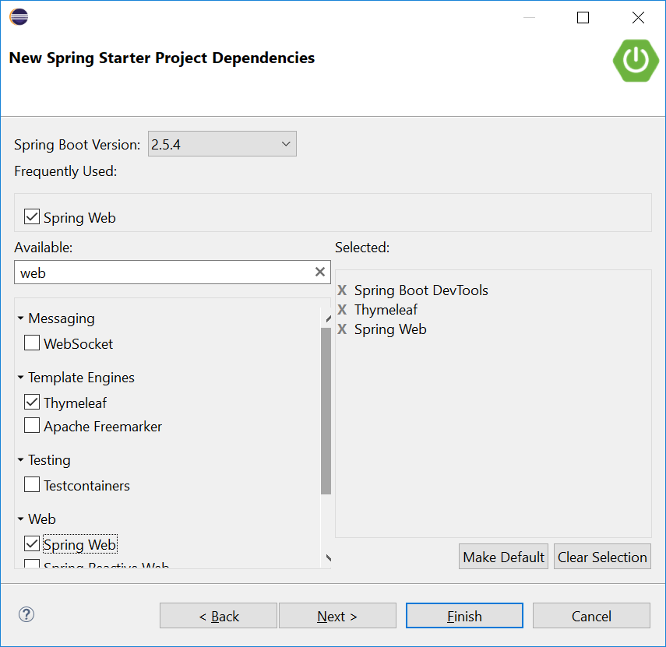
Exercise 1 – Create your first project
Select the following dependencies:
Spring Boot DevTools
Spring Web
Thymeleaf
Click Finish.
Notes:
Lecturer to get students to check at this stage, if the dependencies are correctly selected
Dependencies will be discussed later on.

Slide 28
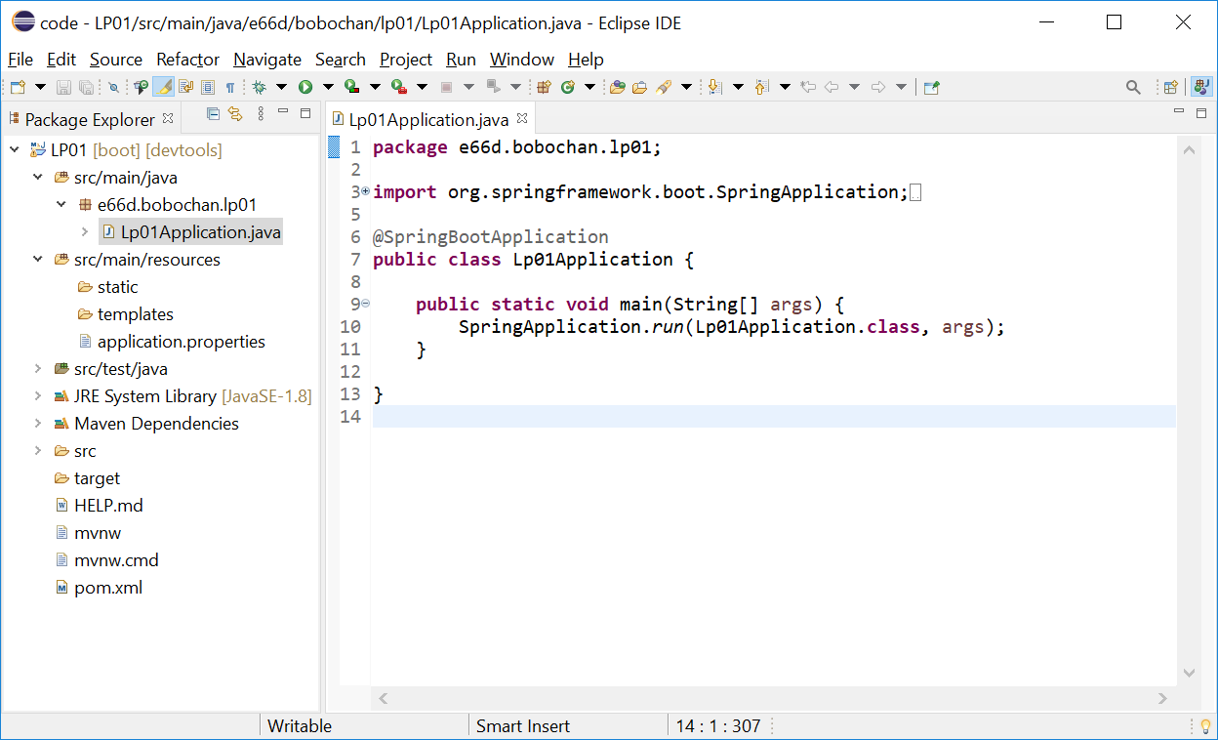
Exercise 1 – Create your first project
You should see the below project folder structure
Check that your project has:
Similar project structure to the image shown here
Lp01Application.java (This file is generated by default.)
No red lines or exclamation marks
Inform your lecturer if the project does not look right at this stage.

Slide 29
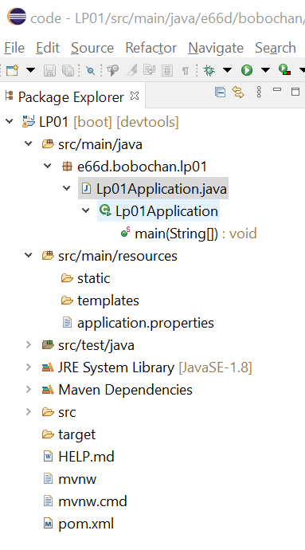
Spring Boot project structure
LP01Application.java is automatically created for you. In it, you will find a main method.
This location will also be where you place Java files.
This is where you put configuration information, such as the database url, username and password.
This is where you will place CSS, JS, and image files.
This is where you will place HTML files.
This is where the dependencies are stored.
This file tells Maven to execute and download the dependencies required for a particular project.
Notes:
Highlighted notes are important for today’s lesson.

Slide 30
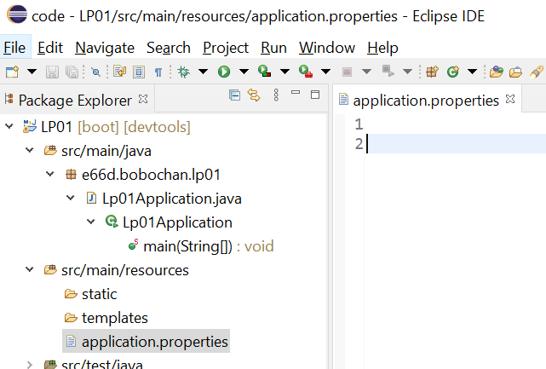
Application.properties
When you first open this file, it will be empty.
This is where we include configurations to tell Springboot where to locate resources such as the database. We will discuss this further in later lessons.

Slide 31
Pom.xml - Overview
The Project Object Model(POM) file is an XML file that contains information about the project and configuration details used by Maven to build the project
When executing a task or goal, Maven looks for the POM in the current directory. It reads the POM, gets the needed configuration information, then executes the goal.
Some of the configuration that can be specified in the POM are the project dependencies, the plugins or goals that can be executed, the build profiles, and so on.
Other information such as the project version, description, developers, mailing lists and such can also be specified.
Notes:
https://maven.apache.org/guides/introduction/introduction-to-the-pom.html
No need to go into details of how to write the POM file. It is usually generated based on our selection of the dependencies when we create the project.

Slide 32

Pom.xml - Maven
https://maven.apache.org/
Apache Maven is a software project management and comprehension tool.
Based on the concept of a project object model (POM), Maven can manage a project's build, reporting and documentation from a central piece of information.
Maven is a tool that can be used for building and managing any Java-based project.
Notes:
https://maven.apache.org/what-is-maven.html

Slide 33
Pom.xml
In this file, you will see a list of dependencies.
Dependencies are what is required by a project to run.
In today’s lesson, we selected the following dependencies when creating the project:
Spring Boot DevTools
Spring Web
Thymeleaf
These dependencies allow us to create an application that can be viewed on the web.
Notes:
Think of dependencies as additional libraries on top of what the basic Spring supplies. Or in the previous module, on top of the basic Java libraries, we had to import certain libraries such as the ArrayList when we needed to use it.

Slide 34
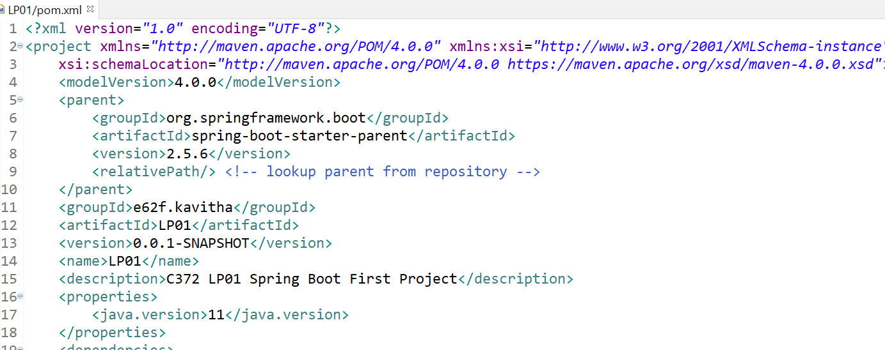
Pom.xml - parent
Java version
Groupid, artifactId, version of springboot
It is declaring the project created is the child of the parent project “spring-boot-starter-parent” which contains all the maven dependencies
Notes:
Think of dependencies as additional libraries on top of what the basic Spring supplies. Or in the previous module, on top of the basic Java libraries, we had to import certain libraries such as the ArrayList when we needed to use it.

Slide 35
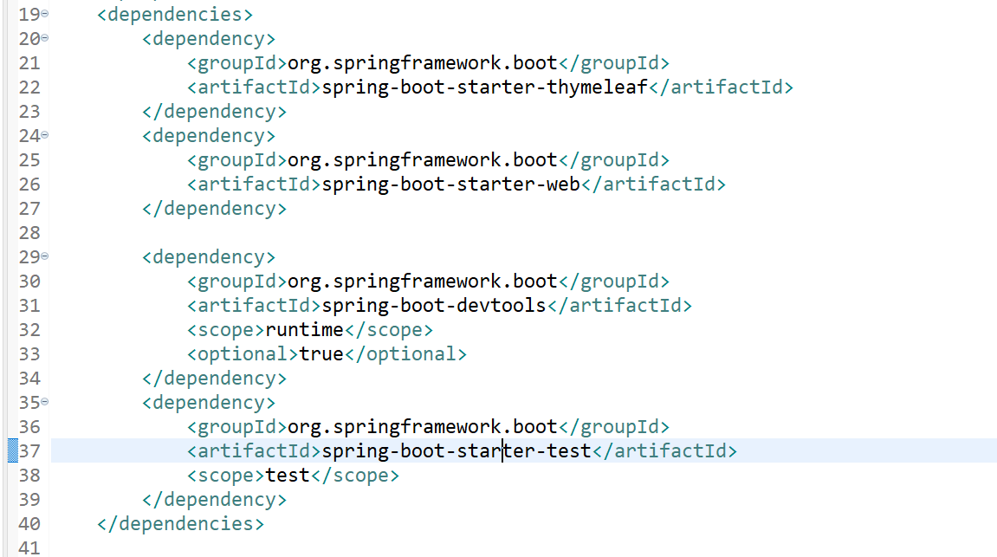
Pom.xml - dependencies
Dependencies → such as Thymeleaf, spring boot web and spring boot development tools
Notes:
Think of dependencies as additional libraries on top of what the basic Spring supplies. Or in the previous module, on top of the basic Java libraries, we had to import certain libraries such as the ArrayList when we needed to use it.

Slide 36
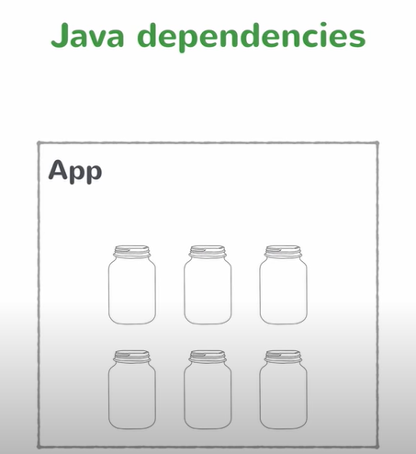
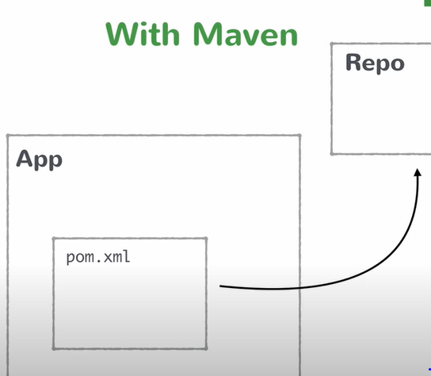
Java dependencies
Java dependencies jar files are downloaded in an application.
Maven allows to declare the dependencies in pom.xml
It downloads all the jar files from the repository based on the dependencies declared in pom.xml for the application.
Notes:
https://maven.apache.org/guides/introduction/introduction-to-the-pom.html
No need to go into details of how to write the POM file. It is usually generated based on our selection of the dependencies when we create the project.

Slide 37
Exercise 2: Resource locations
Fill in the blanks below for the appropriate locations to place our resources.
The first one is done for you.
Resource | Location in a springboot project
CSS files | src/main/resources/static
JavaScript files
HTML files
Image files

Slide 38
Resource locations
Fill in the blanks below for the appropriate locations to place our resources.
The first one is done for you.
Resource | Location in a springboot project
CSS files | src/main/resources/static
JavaScript files | src/main/resources/static
HTML files | src/main/resources/templates
Image files | src/main/resources/static

Slide 39
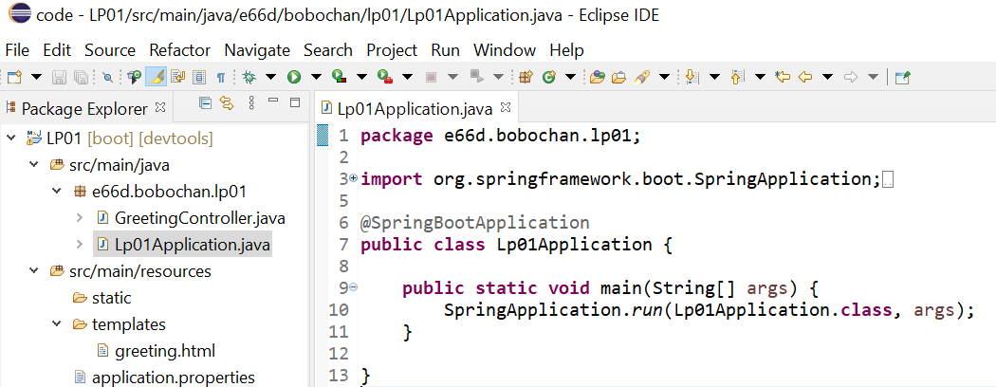
Spring Boot Application
@SpringBootApplication → Starting point of the application.
SpringApplication.run → SpringApplication is a static class which has a method called run that takes in two arguments, the first argument is the name of the class which has the main method, and the second argument is the argument to the main method.

Slide 40
Run Spring Boot Application
Sets up default configuration
Starts Spring application context
Performs class path scan
Starts Tomcat server

Slide 41

LUNCH

Slide 42
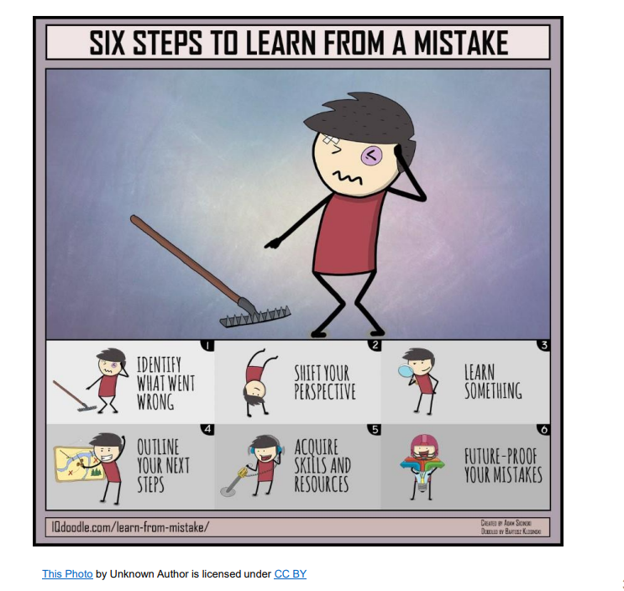

Slide 43
REST API MVC – Models, Views and Controllers

Slide 44
Models, Views and Controllers
Model
A model class represents the data and data logic
View
A view renders the HTML content and displays the content on the client(e.g., web browser).
Controller
A controller class processes any incoming requests and returns a view as a response.
Notes:
Today we will discuss about the view and controller only.

Slide 45
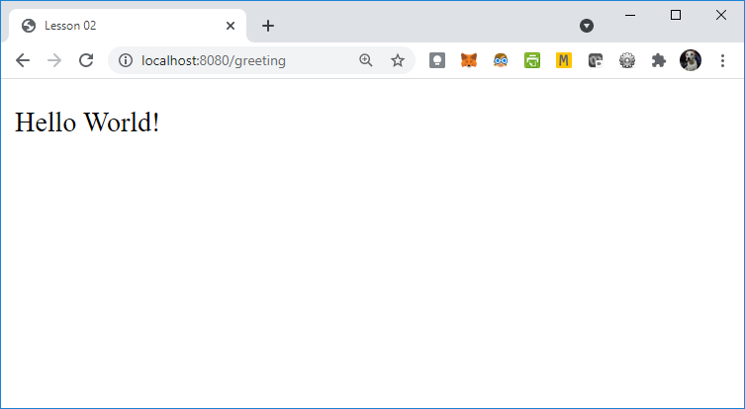
Exercise 3 – Hello World!
Now let’s do something with the project you have created earlier.
We are now going to create a page that will display “Hello world!” on a web browser with Springboot.

Slide 46
Exercise 3 – Hello World!
We will be creating the following files:
Controller – GreetingController.java
View (Web page) – greeting.html

Slide 47
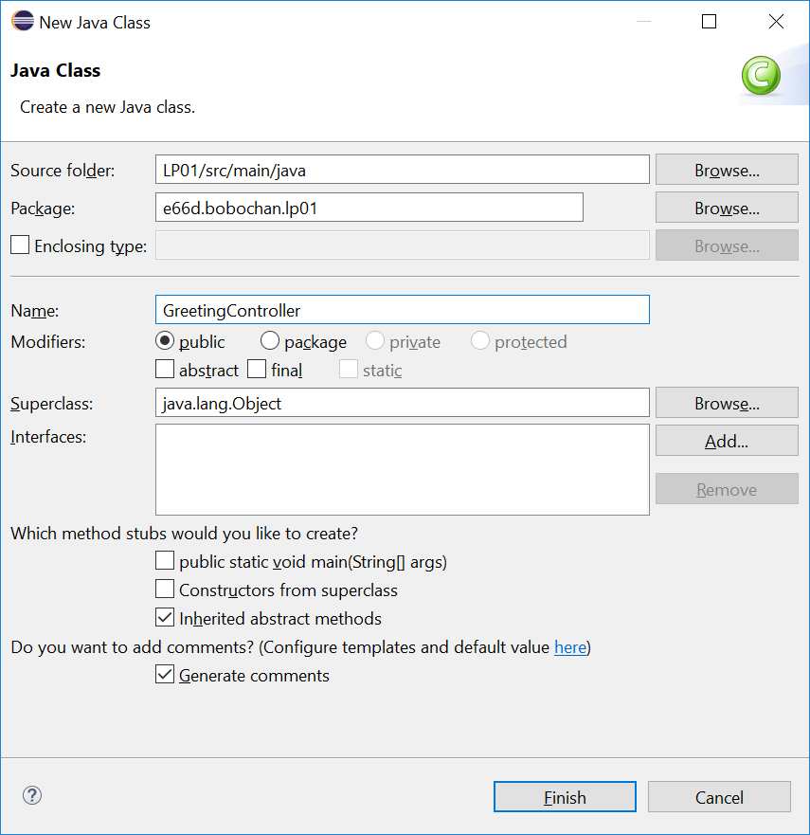
Exercise 3 – Hello World!- Controller
Create a new class under the studentClass.studentname.lp01 package. (You can right-click on the package itself and select New > Class)
Name the class GreetingController, click Finish
Note:
Controller class names should end with “Controller”
Notes:
Remind students to check their package names

Slide 48
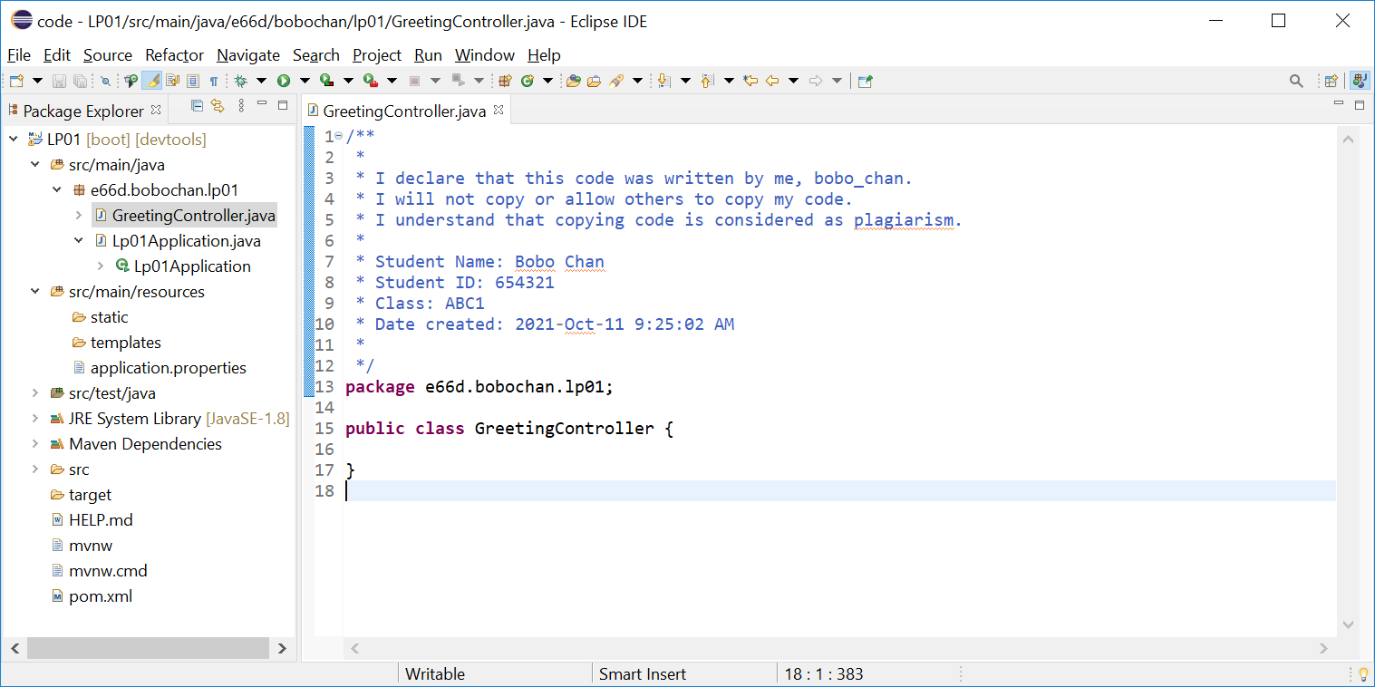
Exercise 3 – Hello World!- Controller
You should now see the following
Notes:
Remind students they should have set their authorship.

Slide 49
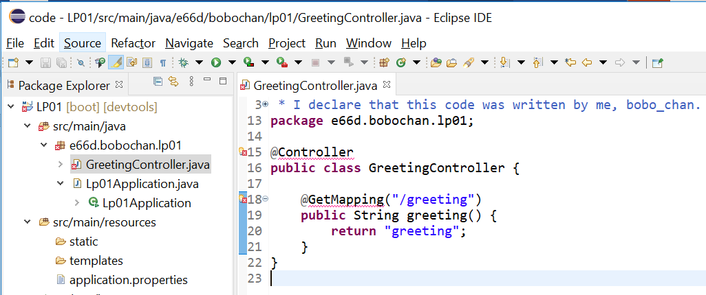
Exercise 3 – Hello World!- Controller
Modify GreetingController as shown below.
How would you solve the errors in lines 15 and 18?
@Controller tells spring boot GreetingController is a controller class.
Notes:
In C208/C209, students were taught that they could import libraries that were missing. They can do so similarly here.

Slide 50
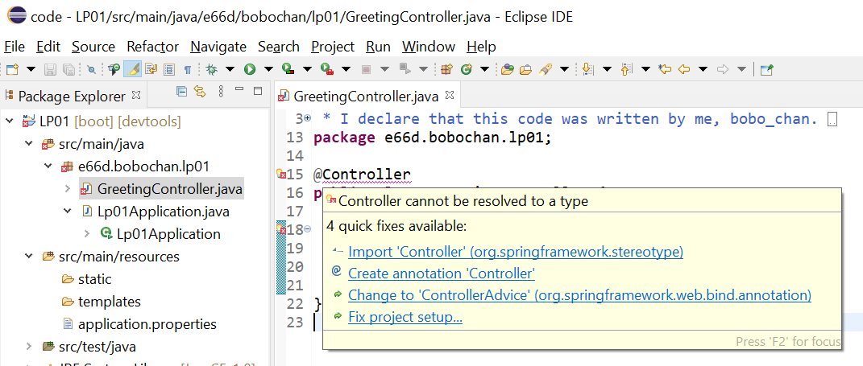
Exercise 3 – Hello World!- Controller
Mouse over the error in line 15, you should see the yellow box as shown.
Select Import ‘Controller’ (org.springframework.stereotype)

Slide 51
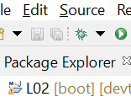
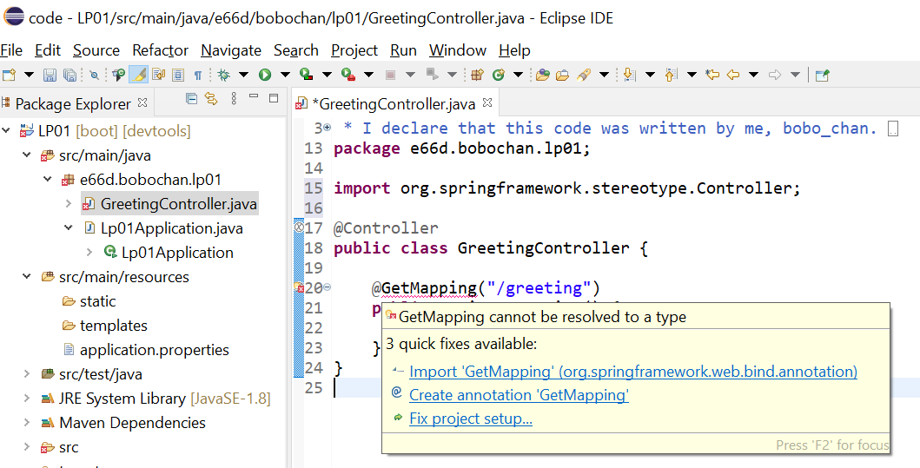
Exercise 3 – Hello World!- Controller
Mouse over the error in line 20, you should see the yellow box as shown.
Select Import ‘GetMapping’ (org.springframework.web.bind.annotation)
Save the file. (Click on the icon or Ctrl-s)

Slide 52
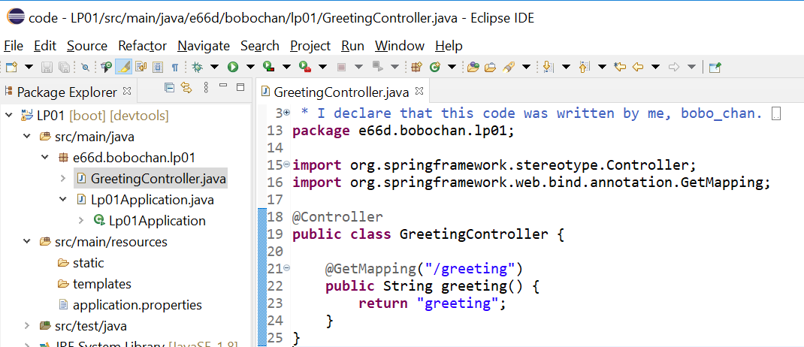
Exercise 3 – Hello World!- Controller
There should be no red lines anymore in GreetingController.java

Slide 53
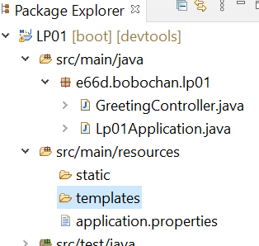
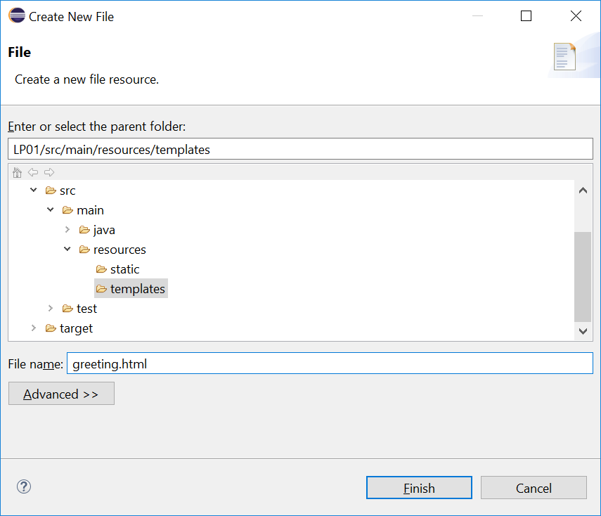
Exercise 3 – Hello World!- View
Right-click on the templates (Under src/main/resources) folder as shown
Select New > File
Give the file the name greeting.html
Click Finish

Slide 54
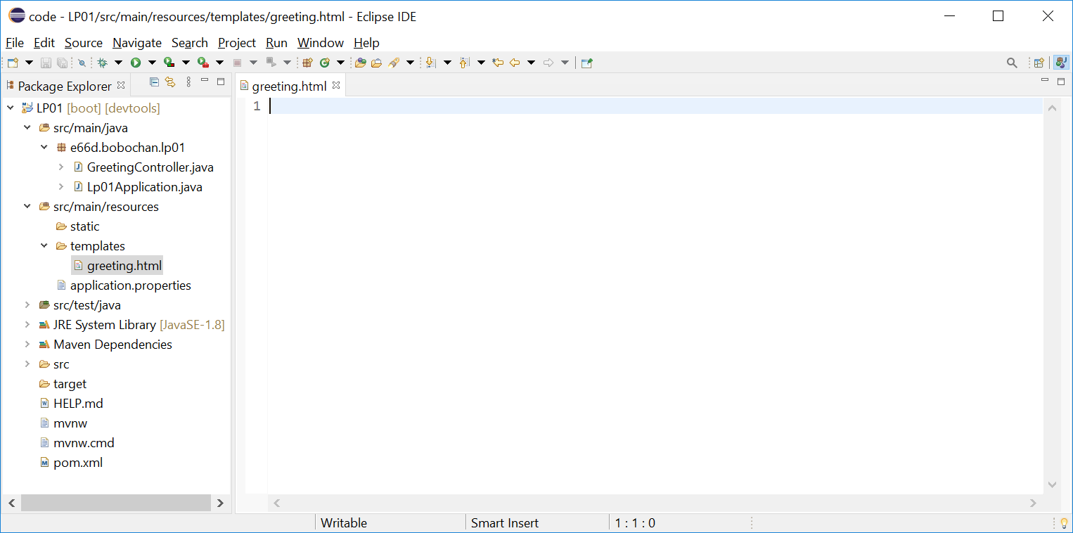
Exercise 3 – Hello World!- View
You should see greeting.html as shown

Slide 55
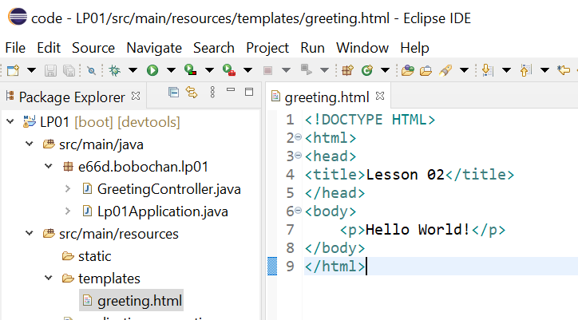
Exercise 3 – Hello World!- View
Type the code as shown into greeting.html

Slide 56
Exercise 3 – Hello World!- Run
Now we can run our code and view our webpage!
Remember we have a class with a main method?
To execute our program, we will need to run the class with the main method.

Slide 57
Exercise 3 – Hello World!- Run
Open L01Application.java and click the button as shown to execute the program.
If you are prompted what to run the program as, select Spring Boot App
Notes:
No modification to L02Application.java needed.

Slide 58
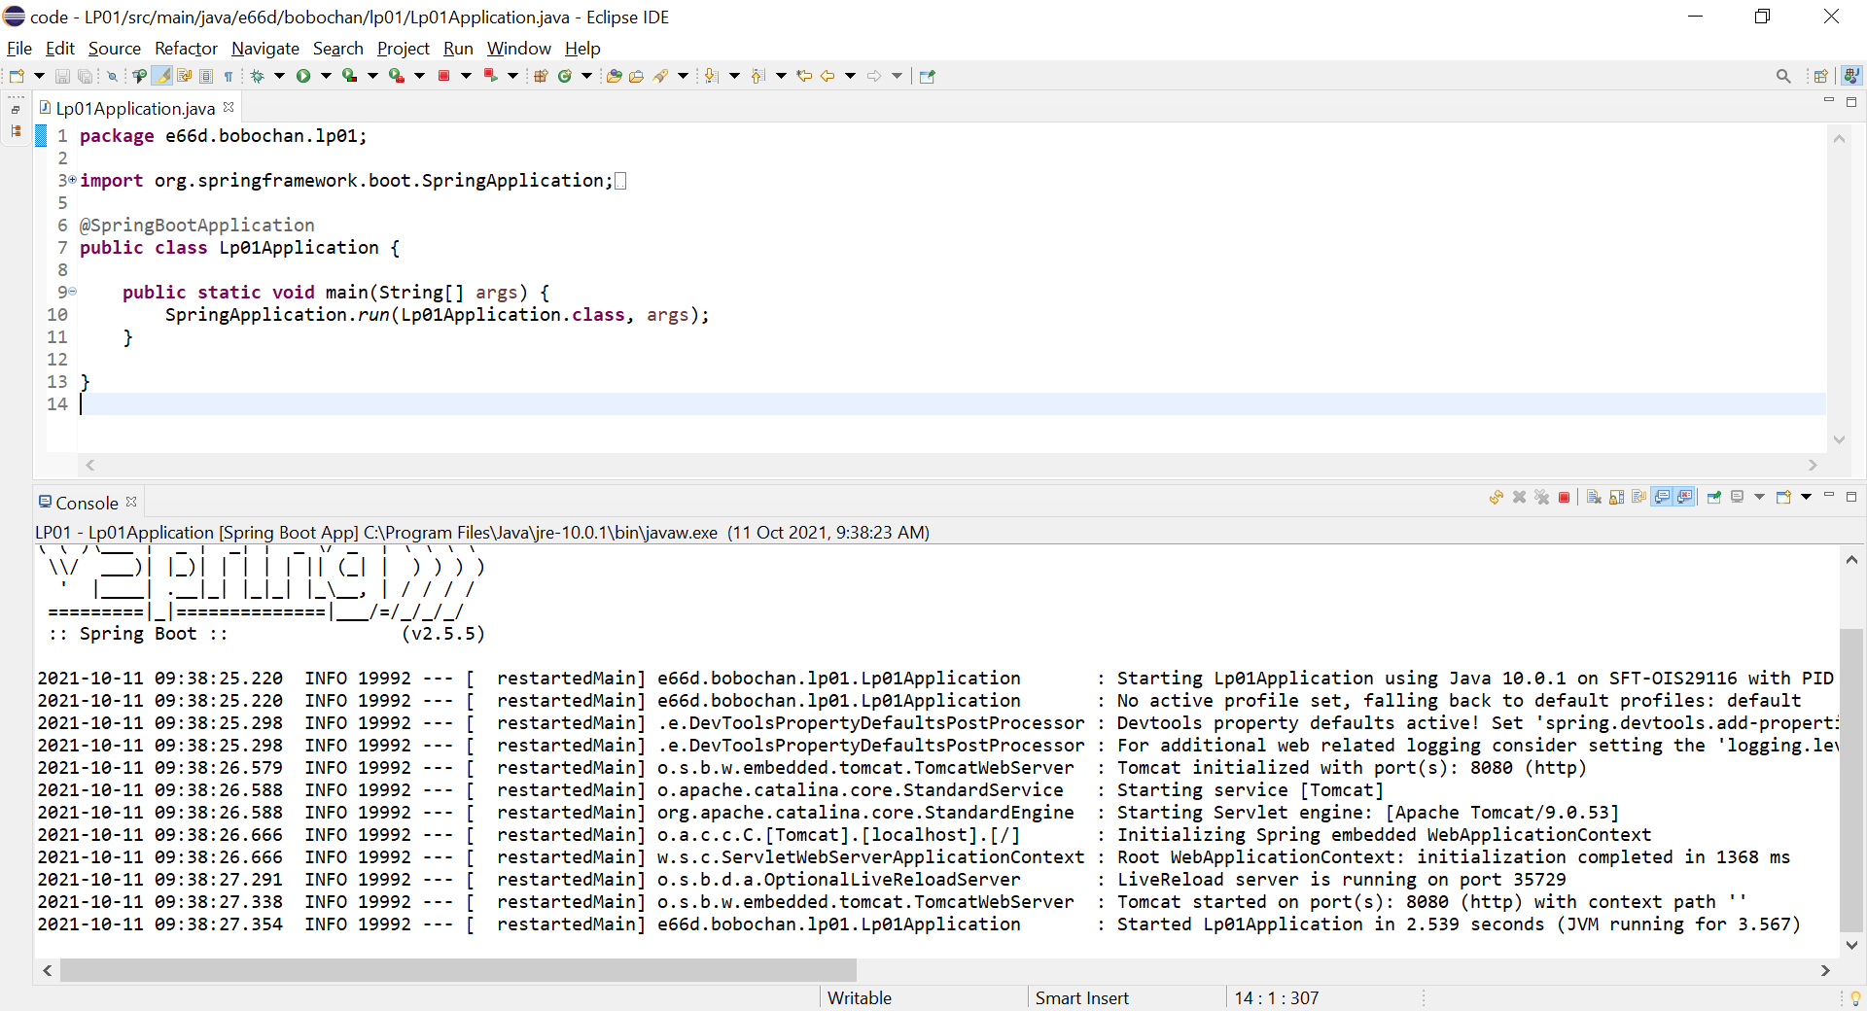
Exercise 3 – Hello World!- Run
If your application has executed successfully without any errors, then you should see the below in your console panel

Slide 59
Exercise 3 – Hello World!- Run
Go to a web browser and type in the following URL:
http://localhost:8080/greeting
Note: Localhost is referring to your local web server, you do not need to be connected to the internet to test your program in this case.

Slide 60
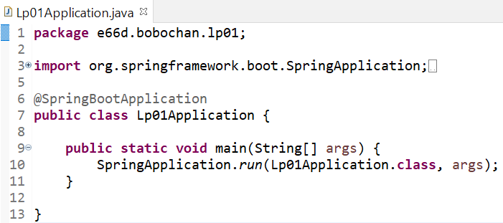
How it works – Application class
The application class is created for you when the project is created.
@SpringBootApplication is an annotation used to mark the main class of a Spring boot application.
The main method uses Spring boot’s SpringApplication.run method to launch an application.
When the application is executed with @SpringBootApplication, the entire project will be scanned for components, configurations or services in the package. E.g. the GreetingController

Slide 61
How it works - Annotations
Spring Boot annotations provide information about a program.
@SpringBootApplication is a convenience annotation that adds all of the following:
@Configuration: Tags the class as a source of *bean definitions for the application context.
@EnableAutoConfiguration: Tells Spring Boot to start adding beans based on classpath settings, other beans, and various property settings.
@ComponentScan: Tells Spring to look for other components, configurations, and services in the com/example package, letting it find the controllers.
Note: Once you use @SpringBootApplication, it replaces the other 3 annotations.
*A bean is simply a Java object.
Notes:
https://spring.io/guides/gs/serving-web-content/
Students need to know that the @SpringBootApplication needs to be used in the class with the main method.

Slide 62
How it works - Annotations
@Controller
When a class is annotated with @Controller, this allows Springboot to automatically detect the classes
@GetMapping(“/greeting”)
Maps “/greeting” to the method(eg. greeting()) that is annotated with @GetMapping.

Slide 63
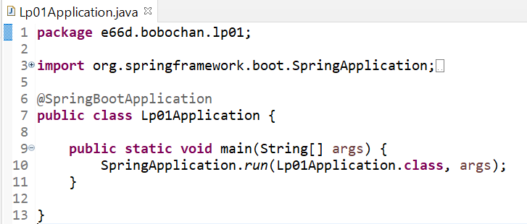
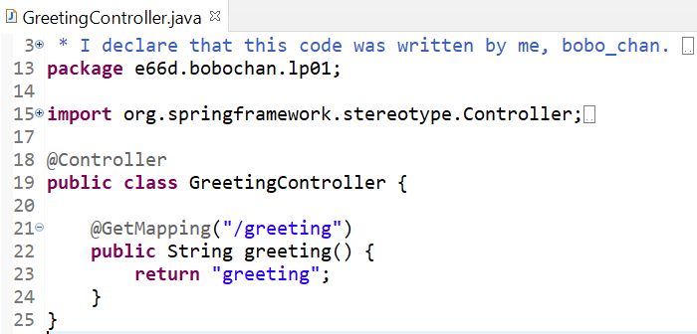
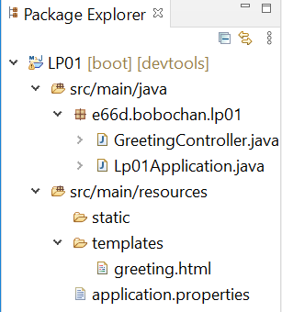
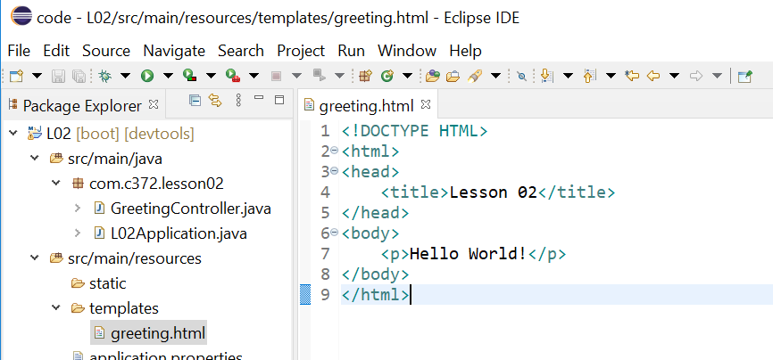
How it works – Controller class, View
1. When the L02Application.java is executed, the @SpringBootApplication annotation will tell Spring to scan for controllers. Classes annotated with @Controller will be identified
2. When a user types the URL http://localhost:8080/greeting into a web browser, the @GetMapping annotation ensures that HTTP GET requests to /greeting (e.g. http://localhost:8080/greeting ) are mapped to the greeting method.
The response returns the greeting.html view. Note that the String value returned here(“greeting”) must match the name of the html file.

Slide 64
REST API - How it works
1. The client makes a request
http://localhost:8080/greeting
2. The web server receives the request and passes it to the controller.
3. GreetingController.java processes request and returns response (View)
greeting.html
(View)
4. The client displays the response received.
Notes:
What web server are we using?

Slide 65
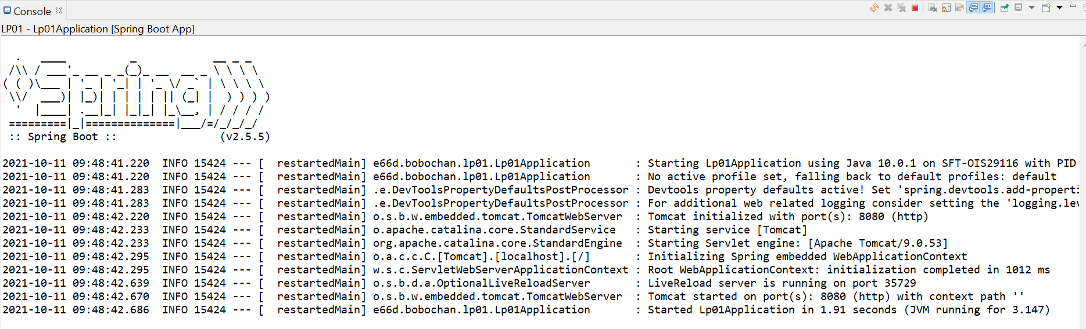
REST API - How it works
When the program is executed, you will see the trace as shown in the console.
Name of the class with the main method, the entry point
Tomcat is the web server that is included in Springboot.
The port is set as 8080. A port is the endpoint of a network connection used to exchange information between the client and server.
This is the port when we use http://localhost:8080
Notes:
In C207, students would have used the Apache webserver

Slide 66
Exercise 4 – How it works
What is the software framework used in this lesson?
In the Spring boot project LP01, what function did GreetingController.java and greeting.html perform?

Slide 67
Exercise 4 – How it works
What is the software framework used in this lesson?
Spring framework with Springboot
In the Spring boot project LP01, what function did GreetingController.java and greeting.html perform?
GreetingController.java processed the incoming requests and returned greeting.html as a response.
greeting.html rendered the HTML content which allowed the web browser to display the information.

Slide 68
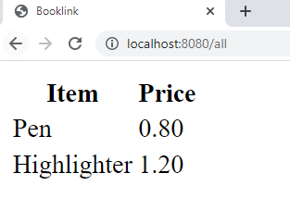
Exercise 5 – Create a Booklink website
Create a project called Booklink and create the required files and write the code to display some static information about some items for Booklink as shown below when we visit the URL: http://localhost:8080/all
Notes:
Give students some time to try on their own before modelling.

Slide 69
Exercise 5 – Create a Booklink Controller
Create a new project File > New > Other > Spring Starter Project and name it as Booklink
Create a Java class named BooklinkController class in studentClass.studentname.booklink package.
Annotate the class with @Controller.
Create a public method named viewAll that returns a String “view_all”.
Annotate the viewAll method with @GetMapping(“/all”)
Notes:
Give students some time to try on their own before modelling.
Package name should be their own

Slide 70
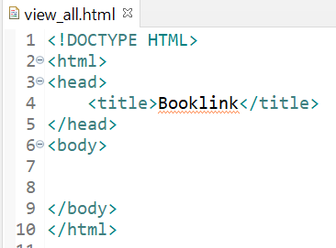
Exercise 5 – Create a Booklink view (HTML File)
Create an HTML file named view_all.html in the templates folder.
Modify view_all.html with the standard HTML structure as shown.
Notes:
Give students some time to try on their own before modelling.

Slide 71
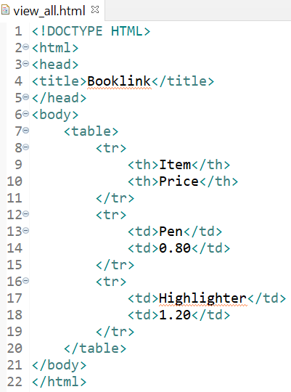
Exercise 5 – Create a Booklink view
Add a table in view_all.html to display 2 items in booklink as shown.
Notes:
Give students some time to try on their own before modelling.

Slide 72
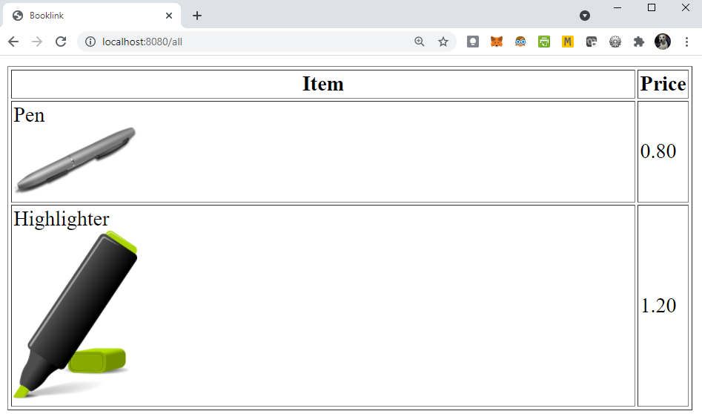
Exercise 5 – Book link Images
Include images into the project and modify view_all.html so that the page for Booklink will display the item details with images as shown below when we visit the URL: http://localhost:8080/all

Slide 73
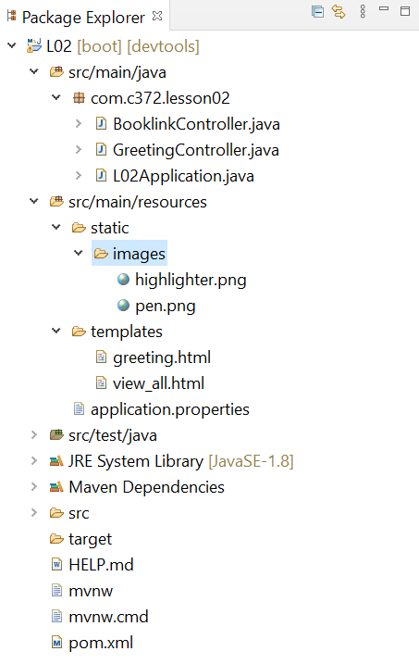
Exercise 5 – Including Images
Images can be included in the application in the static folder under src/main/resources.
Typically, we create a folder named images inside the static folder to organize the files better as we will be including css and js files later.

Slide 74
Exercise 5 – Book link Images
Create a folder named images inside the static folder as shown.
Copy the images provided to you and place them in the images folder.

Slide 75
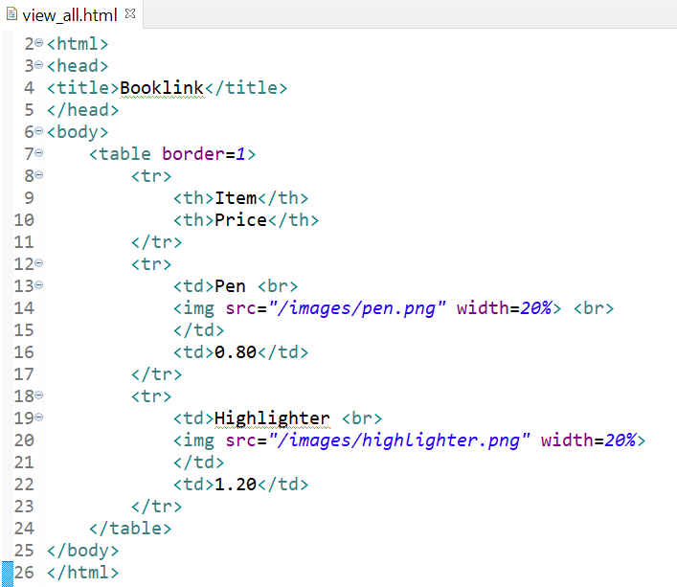
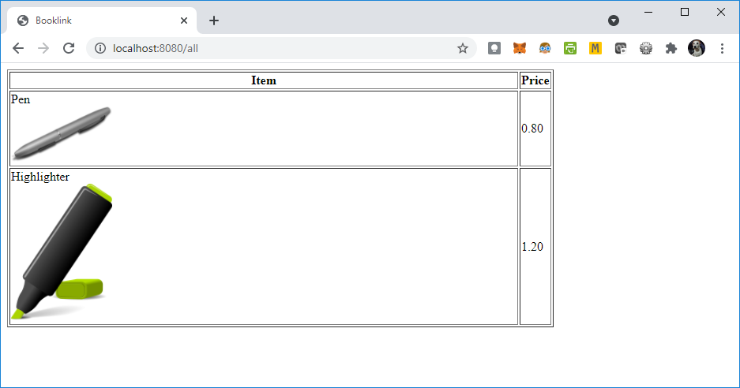
Exercise 5 – Book link Images
Modify view_all.html as shown in the code
The paths shown here under the src attribute is a relative path. In this case, the image paths are relative to the location of the current project.
Relative paths ensure that even if you move the project, for example to the cloud, your links to the images will still work.
If we had used the absolute path of where we stored the image files(which is the full path starting from C:/ or D:/ ), moving the project to cloud will break the links and the images will not be displayed.

Slide 76
BREAK

Slide 77
Styling a web page

Slide 78
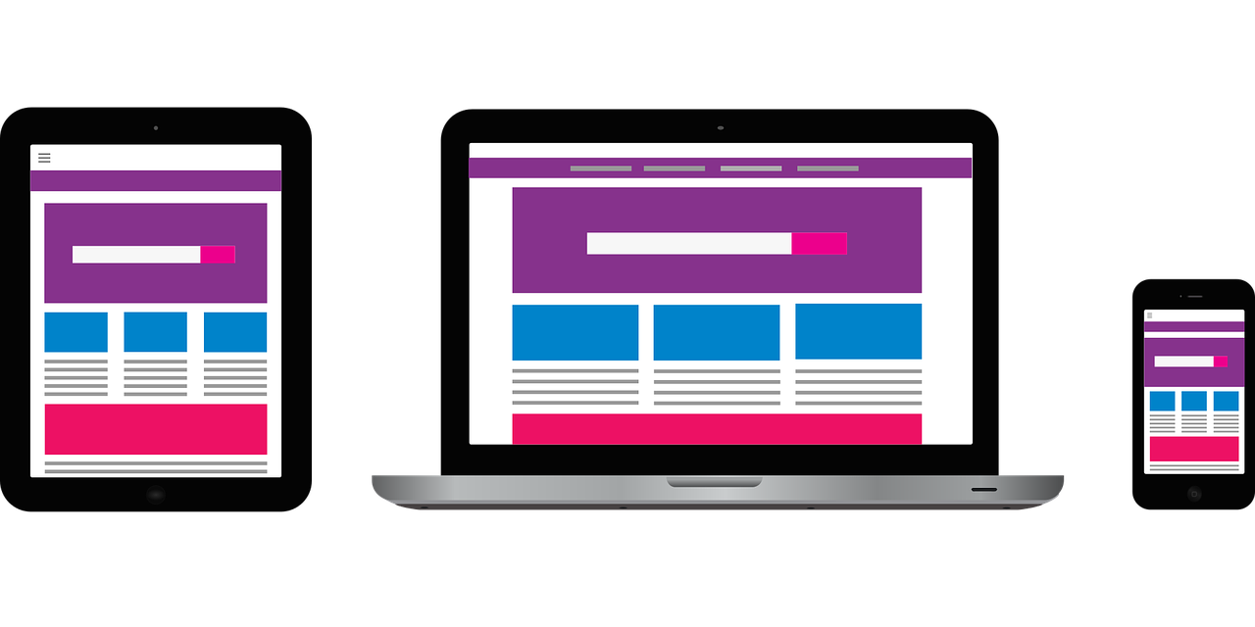
Responsive Web Design
Responsive web design (RWD) is an approach to web design that makes web pages render well on a variety of devices and window or screen sizes from minimum to maximum display size.
Using Bootstrap, responsive websites can be easily created and will adjust accordingly on different devices and screen resolutions.
Notes:
https://en.wikipedia.org/wiki/Responsive_web_design

Slide 79

Bootstrap
Bootstrap is a free and open-source CSS framework directed at responsive, mobile-first front-end web development.
It contains CSS- and (optionally) JavaScript-based design templates for typography, forms, buttons, navigation, and other interface components.
https://getbootstrap.com/
Notes:
https://en.wikipedia.org/wiki/Bootstrap_(front-end_framework)
In C369, students covered the basics of CSS and Javascript

Slide 80
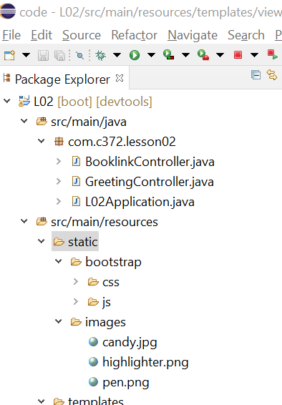
Bootstrap Files
The bootstrap libraries have been provided to you, copy the bootstrap folder to the static folder.
Inside the bootstrap folder, you should see the css and js folder.

Slide 81
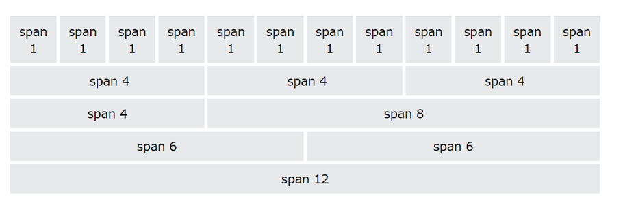
Bootstrap – Container class
Containers are the most basic layout element in Bootstrap and are required when using the default grid system.
Containers are used to contain, pad, and (sometimes) center the content within them. While containers can be nested, most layouts do not require a nested container.
Bootstrap grid system allows upto 12 columns across the page

Slide 82
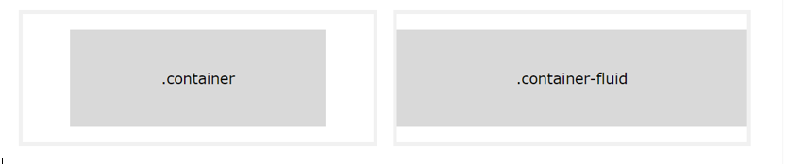
Bootstrap – Container class
Bootstrap comes with three different containers:
.container, which sets a max-width at each responsive breakpoint
.container-fluid, which is width: 100% at all breakpoints
.container-{breakpoint}, which is width: 100% until the specified breakpoint

Slide 83
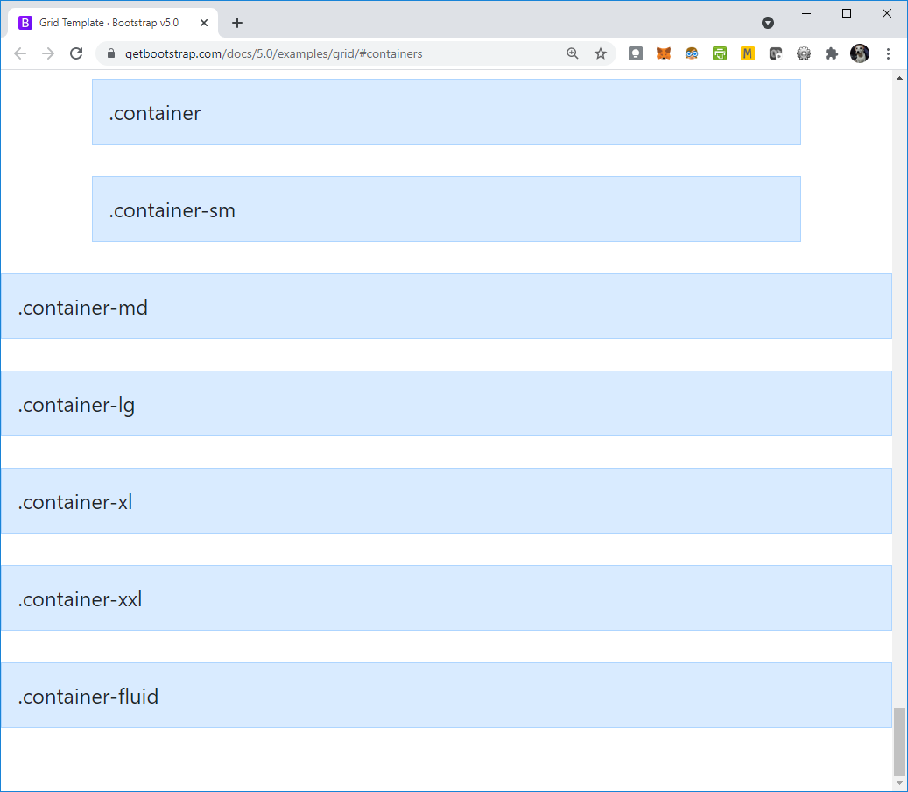
Bootstrap – Container class
Bootstrap has four classes
xs, for phones – screens less than 768px
sm, for tablets - screens equal to or greater than 768 px wide
md, for small laptops - screens equal to or greater than 992 px wide
lg, for laptops and desktop - screens equal to or greater than 1200 px wide
<div class="container">.container</div>
<div class="container-sm">.container-sm</div>
<div class="container-md">.container-md</div>
<div class="container-lg">.container-lg</div>
<div class="container-xl">.container-xl</div>
<div class="container-xxl">.container-xxl</div>
<div class="container-fluid">.container-fluid</div>

Slide 84
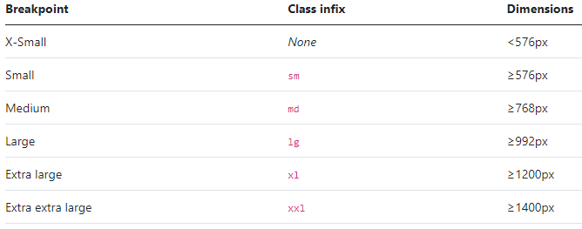
Bootstrap - Breakpoints
Breakpoints are customizable widths that determine how your responsive layout behaves across device or viewport* sizes in Bootstrap.
Bootstrap includes six default breakpoints, sometimes referred to as grid tiers(or responsive tiers), for building responsively.
*The viewport is the user's visible area of a web page.
https://getbootstrap.com/docs/5.0/layout/breakpoints/
Notes:
These breakpoints can be customized if you’re using our source Sass files.

Slide 85
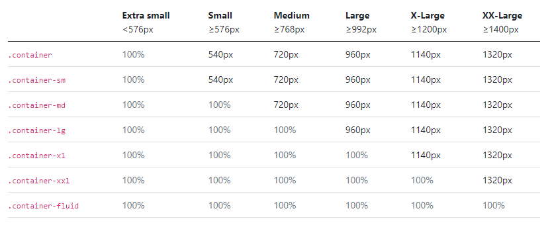
Bootstrap – Container class breakpoints
These are the breakpoints specific to the .container class.
The default .container class is a responsive, fixed-width container, meaning its max-width changes at each breakpoint.
Responsive containers allow you to specify a class that is 100% wide until the specified breakpoint is reached, after which we apply max-widths for each of the higher breakpoints.
For example, .container-sm is 100% wide to start until the sm breakpoint is reached, where it will scale up with md, lg, xl, and xxl.
https://getbootstrap.com/docs/5.0/layout/containers/
Notes:
https://codepen.io/magdalene-lim/pen/vYZQedM
These classes are built into bootstrap. To customise them, you can use media queries.

Slide 86
Exercise 6 - Containers
Go to: https://codepen.io/magdalene-lim/pen/vYZQedM
Maximise your web browser
Scroll down to the “.container-fluid” section
Slowly adjust it from the side so that the web browser becomes “thinner”
Observe the effects of the container classes on the text displayed on the web browser.
Write down your observations.
The contents of the page will adjust to the web browser viewport size.
Notes:
https://codepen.io/magdalene-lim/pen/vYZQedM
Lecturer to demo and explain about the breakpoints as the browser is adjusted.

Slide 87
Exercise 7 – Container classes
Which container class would be suitable if you were designing a webpage for users who will view the webpage on devices of the following viewport sizes and requirements:
768px by 1024px
The content width should be 100%
900px by 600px
The content width should be 960px

Slide 88
Exercise 7 – Container classes
Which container class would be suitable if you were designing a webpage for users who will view the webpage on devices of the following viewport sizes and requirements:
768px by 1024px
The content width should be 100%
900px by 600px
The content width should be 960px
.container-lg

Slide 89
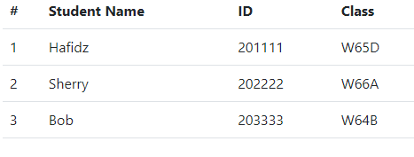
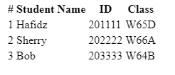
Bootstrap - Tables
When dealing with tabular data, we use the table element to display the data.
Bootstrap provides some classes to easily style tables.
https://getbootstrap.com/docs/5.1/content/tables/
Notes:
https://getbootstrap.com/docs/5.1/content/tables/

Slide 90
Exercise 8 - Tables
Go to: https://codepen.io/magdalene-lim/pen/KKqrRKb
Create a div element with the .container class. The table should be inside this div element.
Modify the table element so that it includes the .table class and looks like the screenshot here. <table class=“table”>

Slide 91
Exercise 8 - Tables
Paste the modified code here:
<table class="table"> <tr> <th>#</th> <th>Student Name</th> <th>ID</th> <th>Class</th> </tr> <tr> <td>1</td> <td>Hafidz</td> <td>201111</td> <td>W65D</td> </tr> <tr> <td>2</td> <td>Sherry</td> <td>202222</td> <td>W66A</td> </tr> <tr> <td>3</td> <td>Bob</td> <td>203333</td> <td>W64B</td> </tr> </table>

Slide 92


Exercise 8 - Bootstrap
Modify view_all.html so that it looks like the code shown.
Refresh http://localhost:8080/all
Notes:
For the purpose of simplifying the demo here, the default container class is used.
Lecturer to show absolute path of the image

Slide 93

Exercise 9 - Bootstrap
What is the purpose of using Bootstrap in a webpage?
Bootstrap helps to style the elements in the webpage to improve the look and feel.
What are the changes in the webpage after applying the classes?
The font family and border have changed, the table is centered

Slide 94

Bootstrap - How it works
This meta viewport element gives the browser instructions on how to control the page's dimensions and scaling.
width=device-width sets the width of the page to follow the screen-width of the device (depending on the device).
initial-scale=1.0 sets the initial zoom level when the page is first loaded by the browser.
This links to the bootstrap css and js libraries.
Notes:
https://www.w3schools.com/css/css_rwd_viewport.asp
Students have previously covered HTML, CSS and JS in C369, however some may have forgotten. Lecturer to show a simple raw CSS code to students.
Ask students how are classes and id represented in CSS
To represent class in CSS code, use .
To represent id in CSS code, use #

Slide 95
Bootstrap containers - How it works
Using the default container class.
Here, we have added 2 classes from the bootstrap library.
Notice we did not need to write any raw CSS code. This is because bootstrap has some pre-defined classes for us to use.(e.g. table, table-bordered)
Notes:
https://www.w3schools.com/css/css_rwd_viewport.asp
Students have previously covered HTML, CSS and JS in C369, however some may have forgotten. Lecturer to show a simple raw CSS code to students.
Ask students how are classes and id represented in CSS
To represent class in CSS code, use .
To represent id in CSS code, use #

Slide 96
Problems with Spring ?
Huge Framework
Multiple set up steps
Multiple configuration steps.
Multiple build and deploy steps.
Notes:
100 different ways to build an application it can be confusing too.

Slide 97
Summary
In this lesson, you learnt about:
The Spring framework
Model-View-Controllers
Creating a simple webpage hosted on a web server
Responsive Web Design - Using Bootstrap to style a web page

Slide 98
Thank You Q&A

